Slide 1

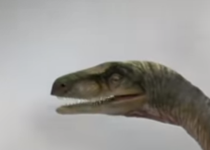
In the figure as shown, a frame is attached to the head of the dinosaur. In this
frame the left eye has the coordinates of (10,6,4). If the dinosaur rotates his head
by 90º about Z axis (towards his left), and his head moves forward by (5,0,0)
what will be the new coordinates of the eye?
Represent the new frame in terms of homogenous transformation matrix with
respect to frame 1.
Z
{1}
X
Y

Slide 2

P
When the helicopter was on the ground (on frame 1), the point P was
having coordinates(0,0,10). Later the helicopter rose to a height of
1000 units and tilted about Z axis by 20 degrees. Determine the
New coordinates of point P. Also determine homogeneous transformation
matrix of frame 2 with respect to frame 1.
w
v
u
Z
{1}
Y
X

